Slide 1
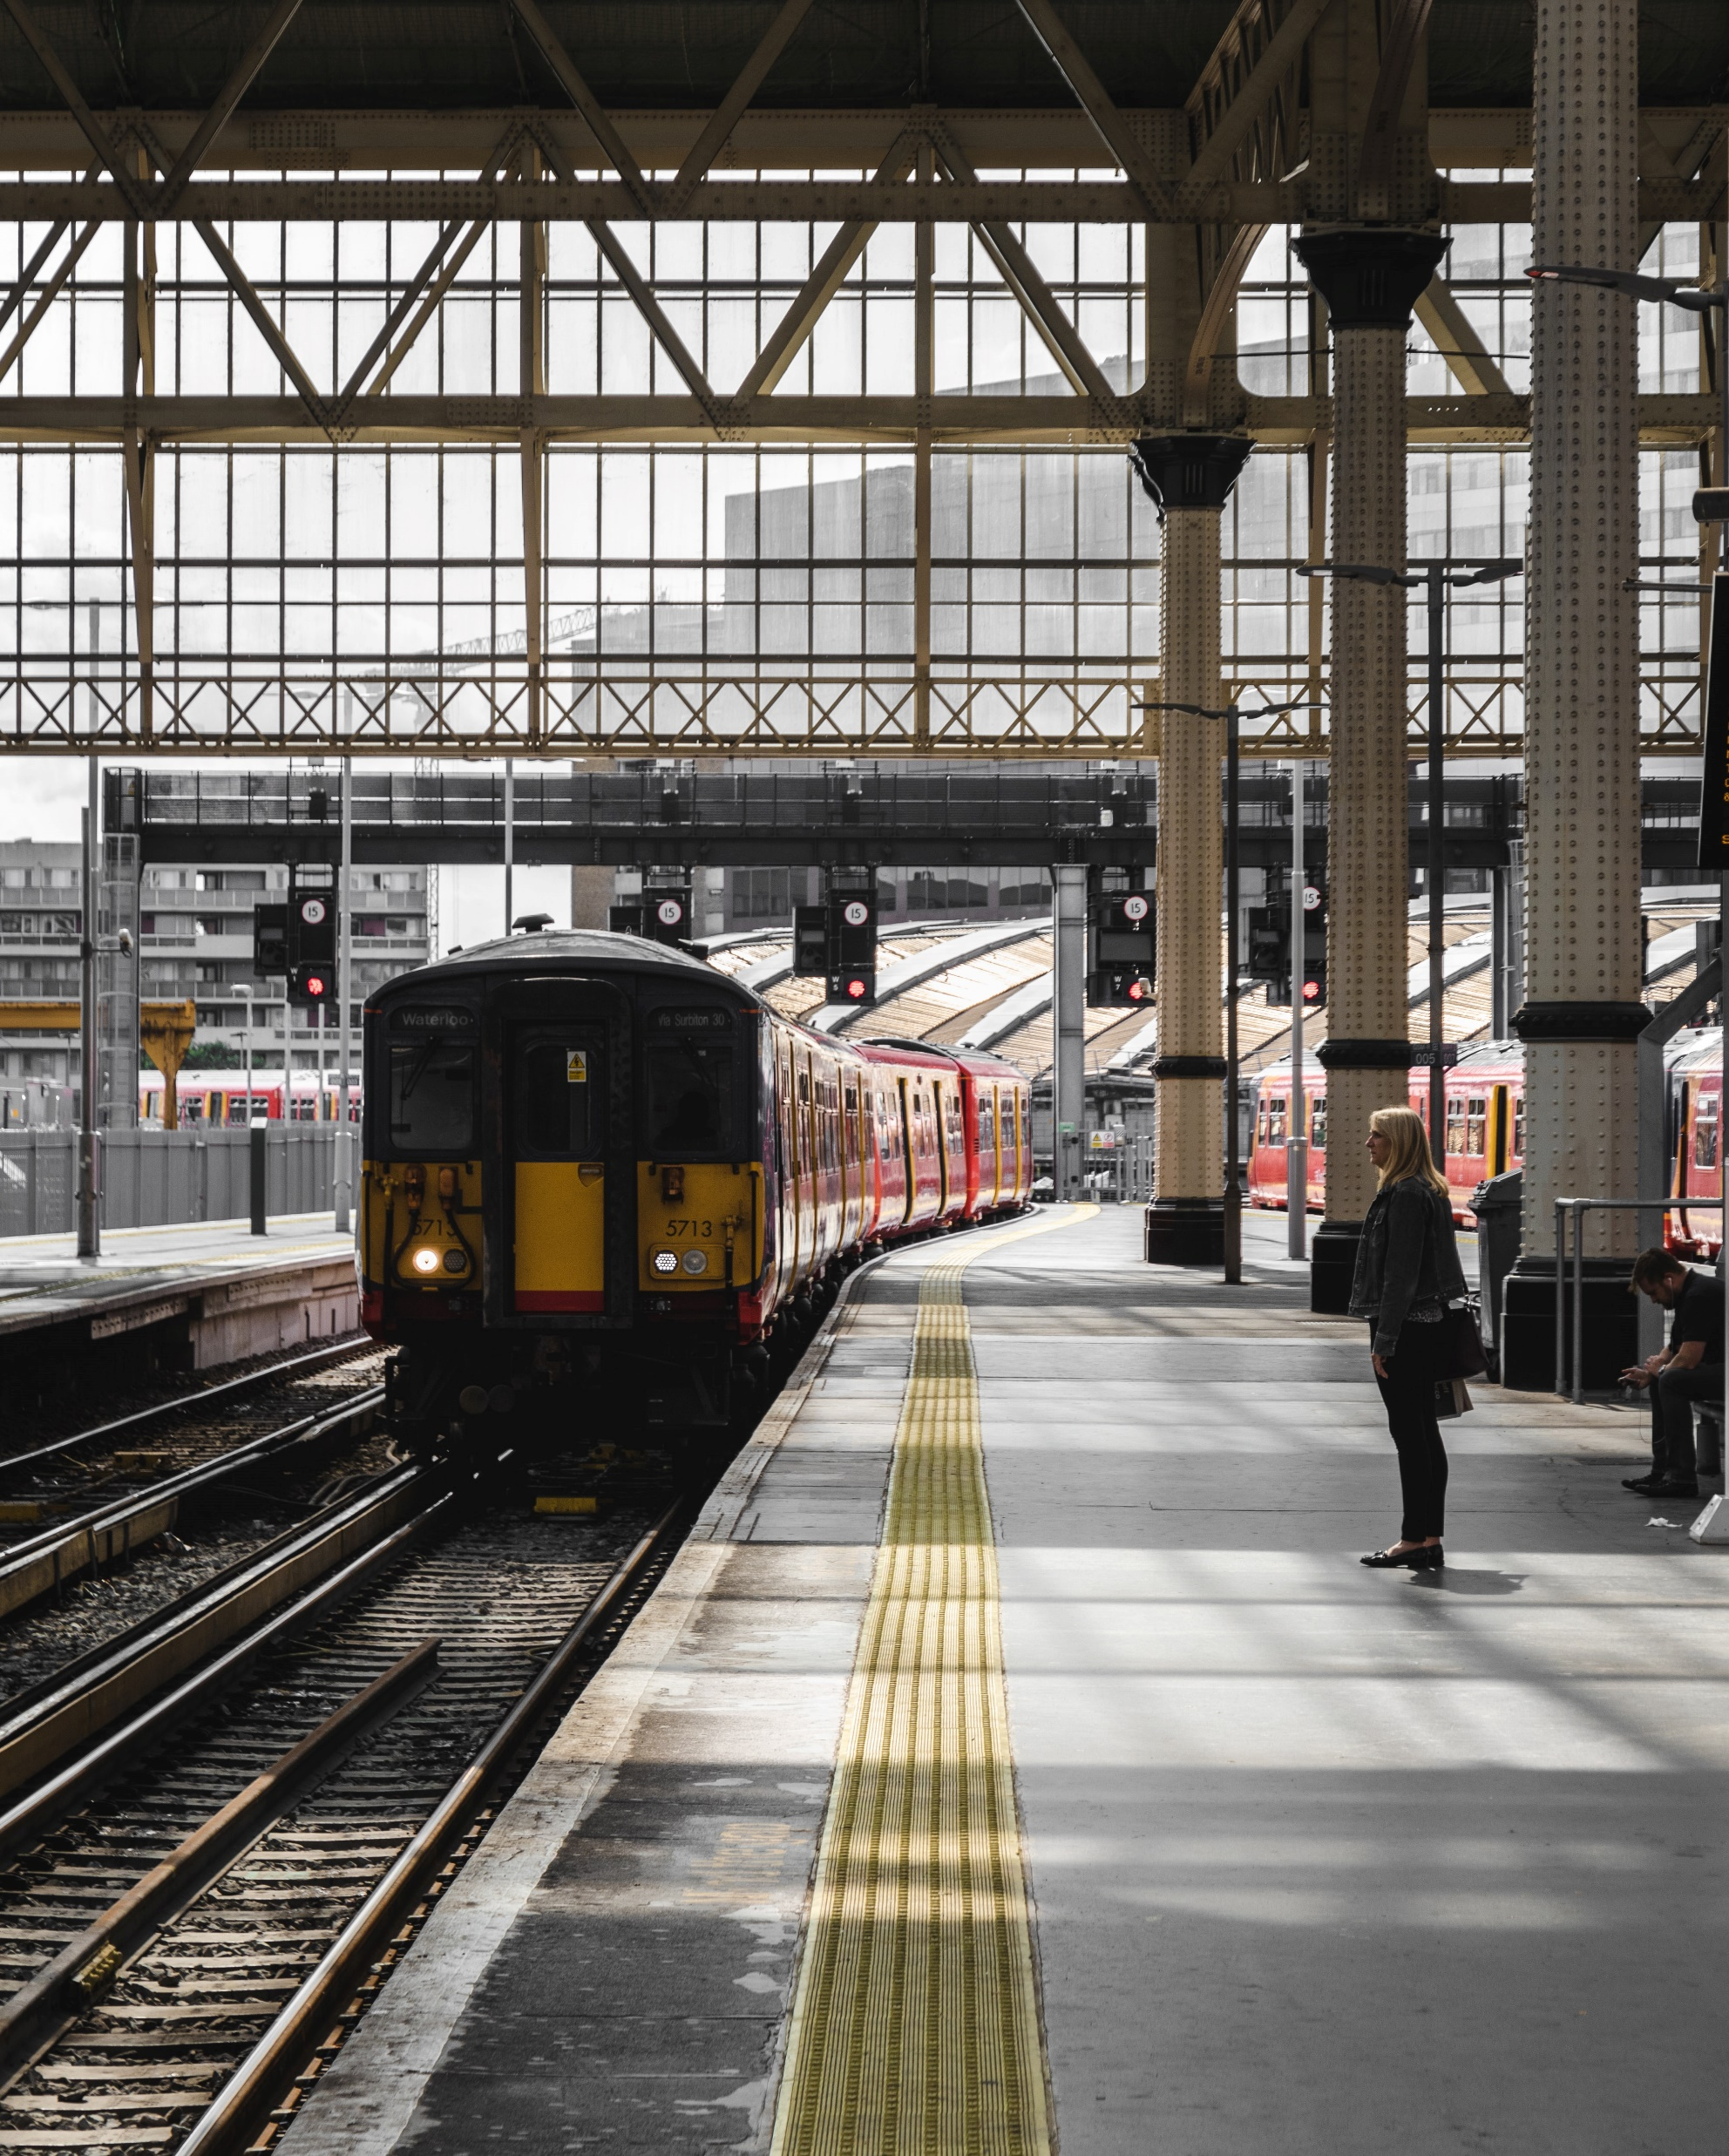
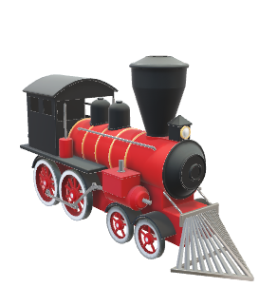
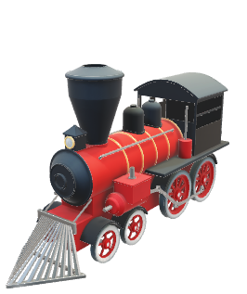
TRAIN TICKET RESERVATION SYSTEM
DIV O | BATCH O2 | GRP NO. 8
PSAP | DESH | VIT PUNE | A.Y.(2020-2021) Term 1
Under Guidance of Yogeshwari Rathod Mam

Slide 2

GROUP MEMBERS
Hi, I am Parikshit Pohane
My roll no. is 42
Hi, I am Ronit Pokharna
My roll no. is 44
Hi, I am Harsh Poddar
My roll no. is 41
Hi, I am Tanmay Pol
My roll no. is 45
Ronit
Parikshit
Hi, I am Ritesh Pokarne
My roll no. is 43
Hi, I am Piyush Sonar
My roll no. is 40
Tanmay
Harsh
Ritesh
Piyush

Slide 3
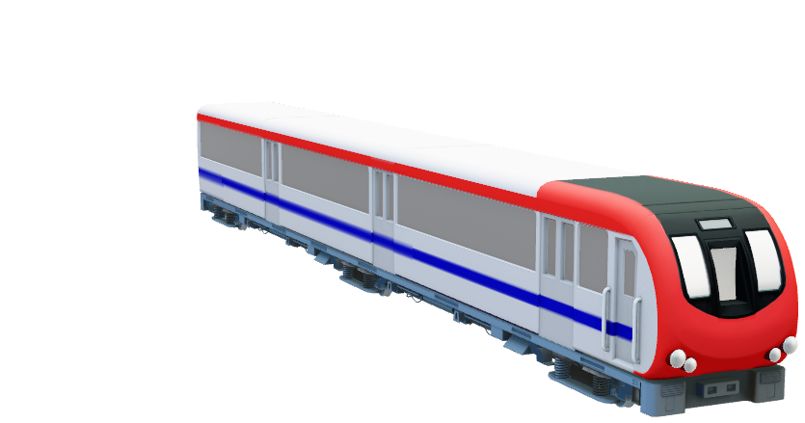
OUTLINE
01
INTRODUCTION
02
PROBLEM STATEMENT
03
OBJECTIVES AND AIMS
04
BACKGROUND
TRAIN TICKET RESERVATION SYSTEM PSAP COURSE PROJECT
05
IMPLEMENTATION
06
RESULTS & DISCUSSION
07
CONCLUSION & SCOPE
08
REFRENCE(WORD)

Slide 4


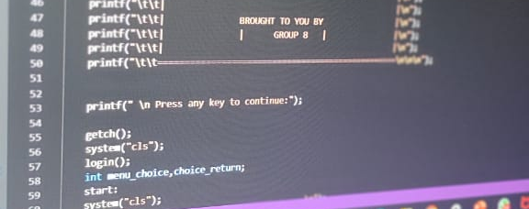

I N T R O D U C T I O N
This System is basically concerned with the reservation of railway tickets to the passengers.
This Train Ticket Reservation System is completely coded in C Programming language.
This System ensures the user to view trains of his desired destination, Reserve the ticket, Cancel the ticket etc.
This System is mainly used in the Traveling Agency who provide the train ticket reservation to passengers.
Railway Ticket reservation can easily accompanied with the help of this System.

Slide 5

PROBLEM STATEMENT
Software has to be developed for automating the manual reservation system of railway.
The existing system is highly manual involving a lot of paper work and calculation and therefore may be erroneous. This has lead to inconsistency and inaccuracy in the maintenance of data.
To Overcome this problem we have designed a Computerized system. The computerization of the reservation system will reduce a lot of paperwork and hence the load on the administrative staff.
These System should be designed to provide functionalities like booking of tickets as well as cancel the tickets in which a user should be able to applied for tickets of any train and of any class.
Train Ticket Reservation System

Slide 6
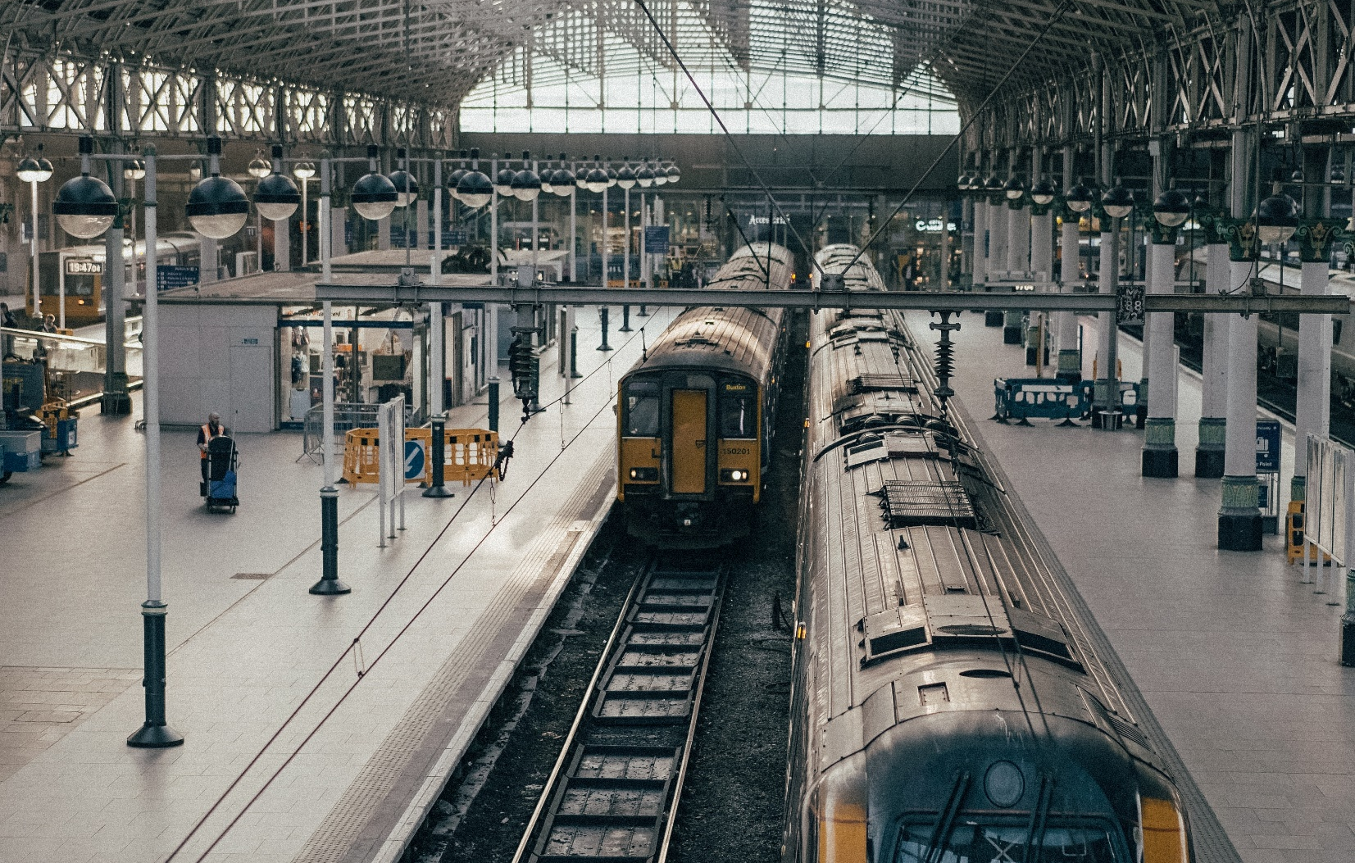
The purpose of this source is to describe the railway reservation system which provides the train timing details, reservation, billing and cancellation on various types of reservation namely : -
OBJECTIVES & AIM
Confirm Reservation for confirm Seat.
Reservation against Cancellation.
All the manual work should be converted into computerized so that the load of employees should decrease.
The database should be stored in computer rather than in register/manually.
These system is aimed to provide a easy interference to passenger to book the ticket.

Slide 7
Limitations & Challenges
LIMITATIONS
CHALLENGES
Multiple User Login
Current status of Trains & Tickets
Availability of Tickets
Unsatisfactory Security concern
Data BASE HANDLING
Ticket Booking execution
Ensuring different class for Tickets
Calculation of Fare
Train Ticket Reservation System

Slide 8
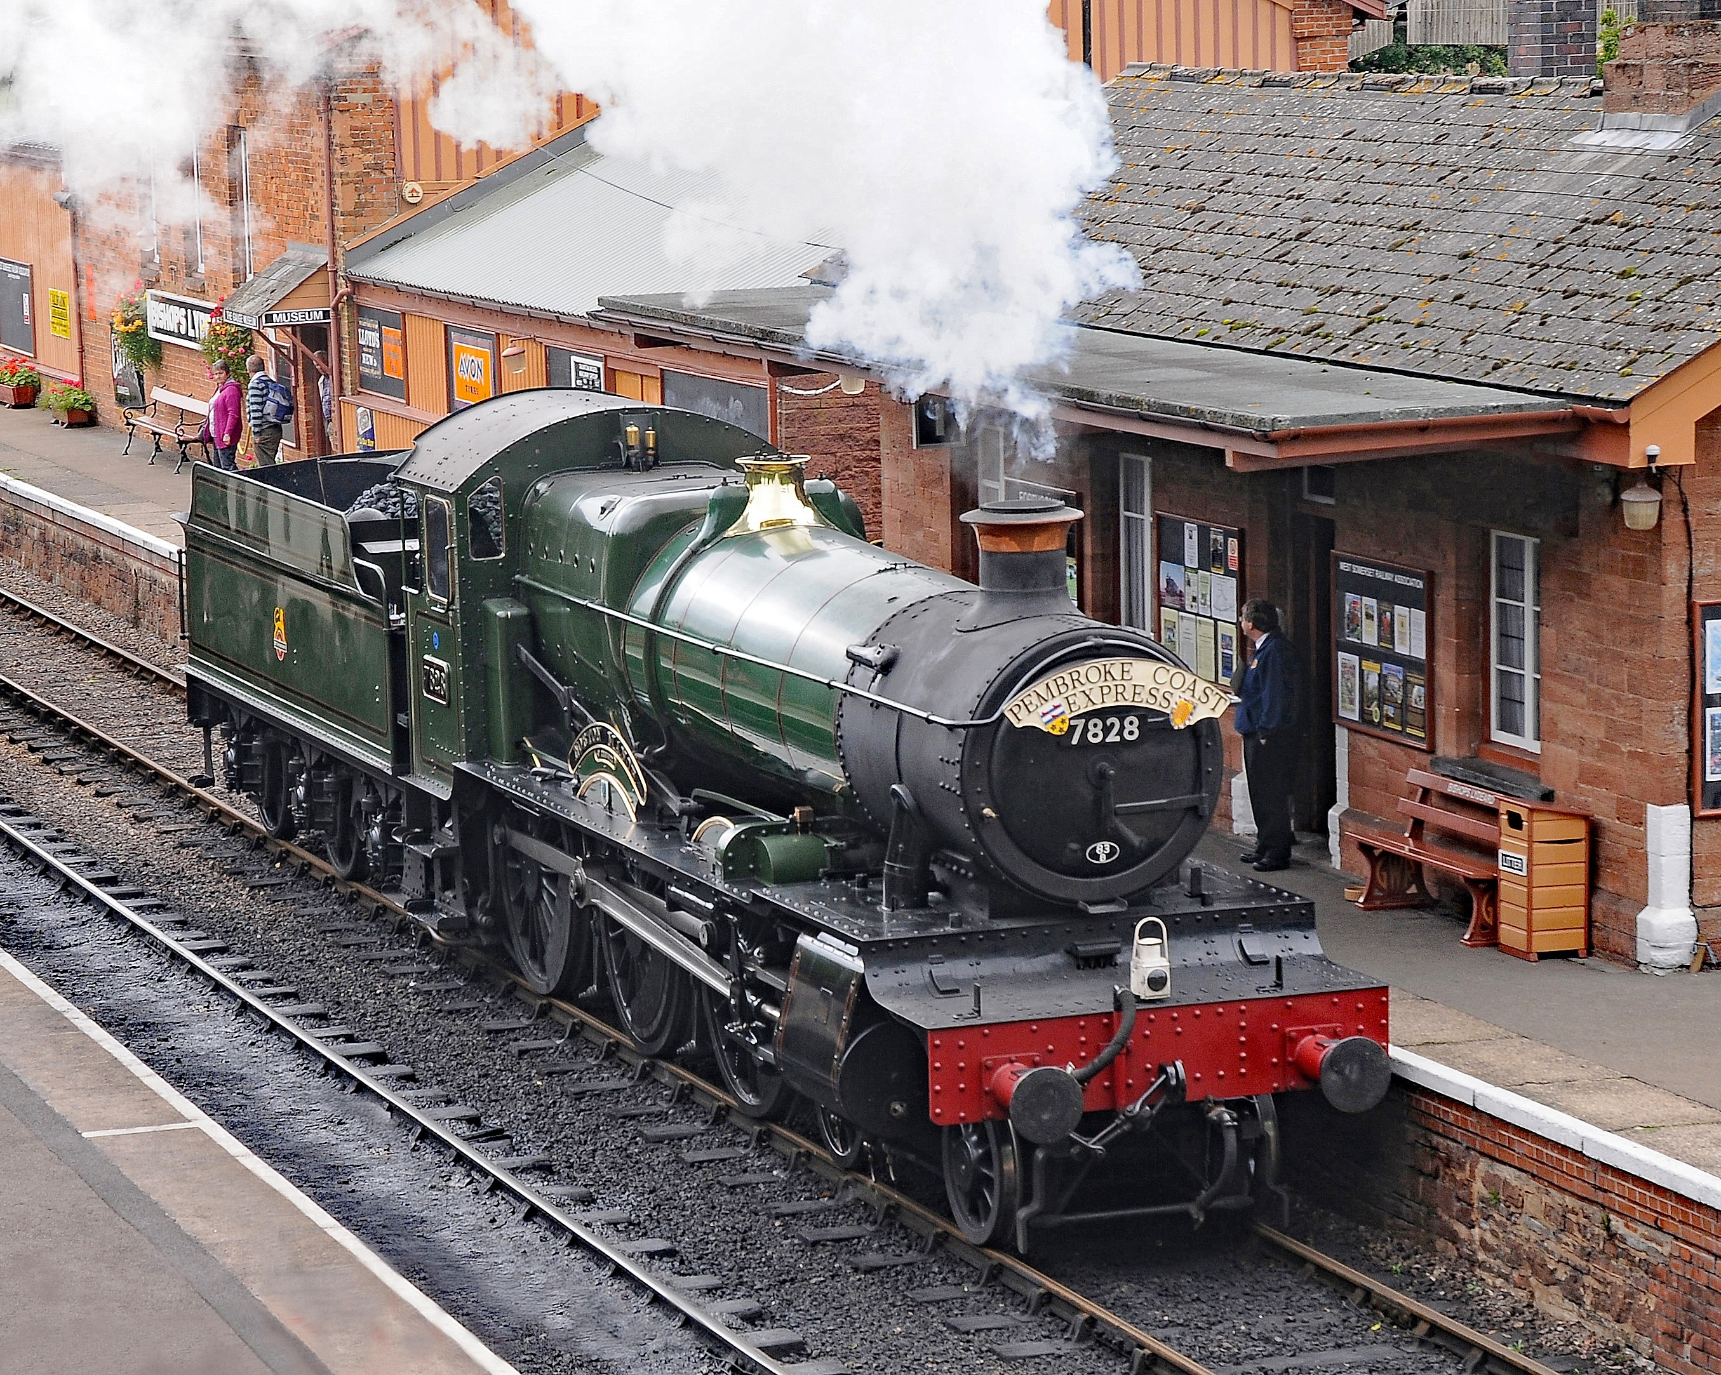
IMPLEMENTATION
Category of the project
Our Course Project which is Train Ticket Reservation System is categorized under File Handling.
Tools & Platform
To work these system we have used C programing Language.
These Program will work on any C Programing Language Compiler Platform such as VS CODE, CODEBLOCKS etc.

Slide 9
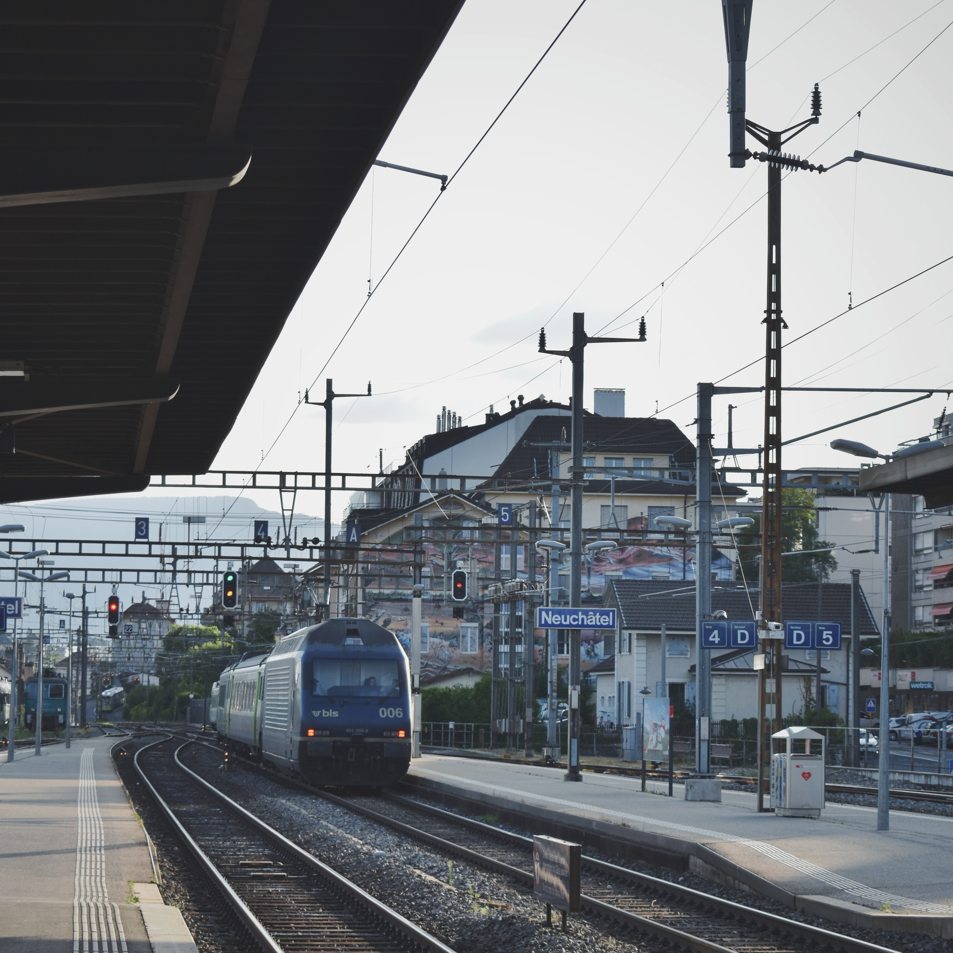
FEATURES
1) Searching of data is easy
2) Information is accurate
3) It is a fast process
4) Data efficiency is more
5) Data can also be accessed after
the program.

Slide 10

Modules
We analyzed and concluded that the project can be implemented by following Modules:-
User LOGIN
TICKET RESERVATION
All TRAINS DATABASE
TICKET CANCElLATION

Slide 11
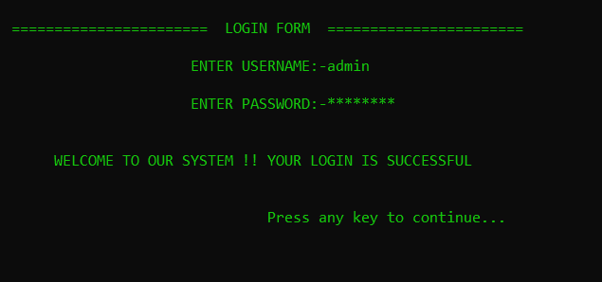
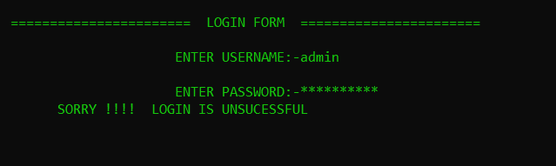
USER LOGIN
The login function is a safety method where two variables username and password are used so first the user will enter the username and password where it will be checked if they are same as the actual details and then only allow the user further. If Login is invalid then it will show that it is unsuccessful.

Slide 12
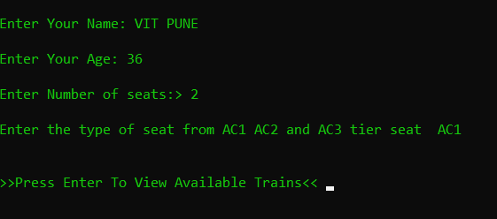
TICKET RESERVATION
The details of the user like name, age ,number of seats and seat type are all stored in respective global variables to be sent to the print ticket function. There can be only 3 type of seat AC1, AC2 and AC3 tier seat in which the user can choose as their need.

Slide 13
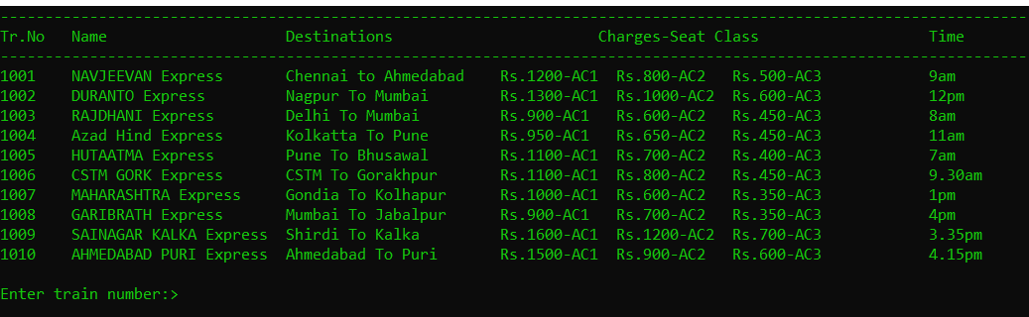
ALL TRAIN DATA BASE
Here, in our program we have added 10 Train’s Data Base. In which we have displayed train number, Train name, Destination, Charges as per ticket class and Time of Train.

Slide 14
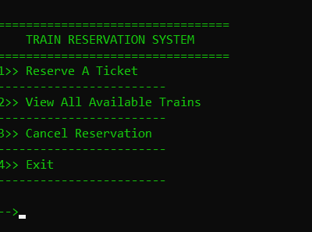
Ticket canceletion
In these Train ticket reservation system we have added four portal in which one of the portal is Cancel Reservation. These is useful to cancel the ticket even after the booking for the user.

Slide 15

ALGORITHM
Step 1: Start.
Step 2: Declare train_num, Num_of_seats, seat_class, Age variables and Initialize it.
Step 3: Input username and password. Check for invalid Input.
Step 4: Print the choices i.e. reserve a ticket, view all available trains , cancel Reservation , exit.
Step 5: Process the input from user by switch case. Check for invalid input.
Step 6: Display all Trains available in the database.
Step 7: Input user details, check for invalid input.
Step 8: Generate ticket and Print ticket details.
Step 9: Store in related database& Return to main menu.
Step 10: End

Slide 16

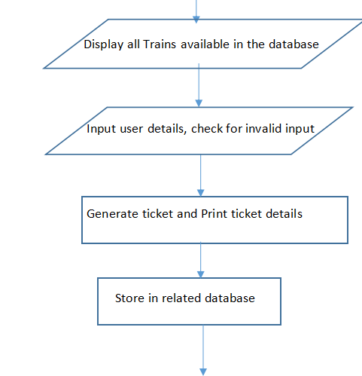
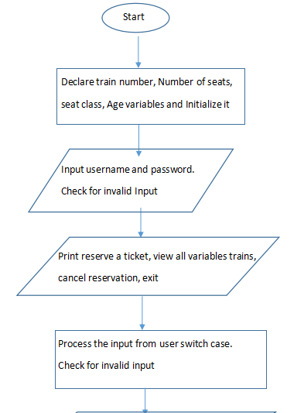
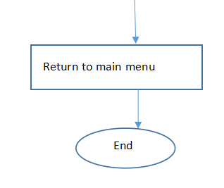
FLOWCHART

Slide 17

PSEUDO CODE
BEGIN
Declare train_num, num_of_seats, seat_class_age, input username, password
Print the choices Reserve a ticket, view all Available trains, cancel Reservation, exit
Input the choice
Display all trains available in the database
Input user details
Generate tickets and print ticket details
Store the detail in the notepad by file handling
END

Slide 18

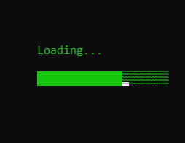
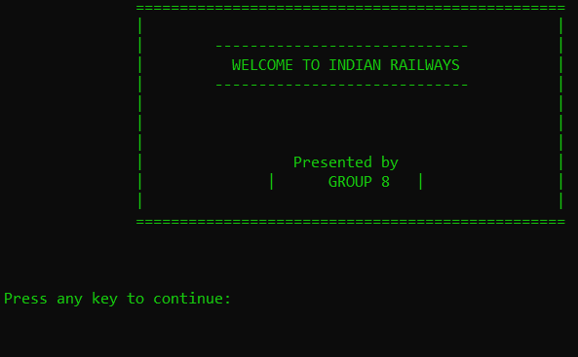

OUTPUT

Slide 19
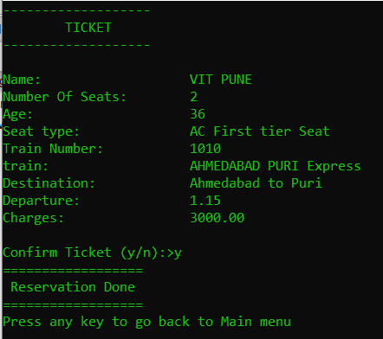
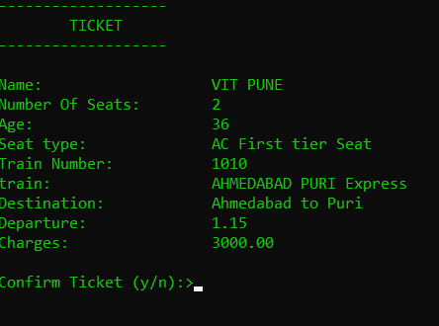

Slide 20
Some More Information about Our Code
Our Code is about 470 lines compiled in C programing Language.
We have used 9 functions such that :-
void specifictrain(int);
float charge(int,int,int);
void login();
void loadingBar();
int main()
void reservation(void);
void viewdetails(void);
void cancel(void);
void printticket(char name[],int,int,float,int,int);

Slide 21
Future scope
01
Extra and user defined security needs can be employed.
02
Records of client activities can be maintained.
Another enhancement would be to add more modules to cover all information off the system
03
In Future there would be Multi Login System.
04

Slide 22
CONCLUSION
Our Program is encrypted by a Login Form.
We provide a easy handling system in which user can Reservation of Tickets, View available Trains, Cancel the Booked tickets etc.
Customer can also vies their Tickets after the execution of program.
The Main thing is that we can access user Data Base even after the execution of program with the help of File handeling.

Slide 23
REFERENCES
[1] Guimaraes, Mario. The Kennesaw Database Courseware (KDC) with an Evaluation Component, Proceedings of 42nd ACM-Southeast Conference, April, 2004, Huntsville, Alabama.
[2] J. Armendariz. Design and Implementation of Database Replication Protocols in the MADIS Architecture . PhD thesis, Universidad Publica de Navarra, Pamplona, Spain, 2006.
[3] P. Bernstein, V. Hadzilacos, and N. Goodman. Concurrency Control and Recovery in Database Systems. Addison
Wesley, 1987.
[4] M. Carey and M. Livny. Conflict detection trade-offs for replicated data. ACM Trans. Database Syst., 16(4):703-746, 1991.
[5] J. Armendariz, J. G. de Mendivil, and F. Munoz-Escoi. A lock-based algorithm for concurrency control and recovery in a middleware replication software architecture. In HICSS, page 291a. IEEE Computer Science, 2005.

Slide 24

Hello, I am Ritesh Pokarne.
I am Captain of these Group.
I have made these PPT & Helped in Coding
Hello, I am Piyush Sonar
I am Tech Ninja.
I have made the code Successfully run
Ritesh
INDIVIDUAL CONTRIBUTION
Piyush
Hello, I am Harsh Poddar
I am Coder
I have made the Code
Hello, I am Tanmay Pol
I am Project Meanie
I have managed the project & made the Research Paper
Harsh
Tanmay

Slide 25
INDIVIDUAL CONTRIBUTION
Hello, I am Parikshit Pohane
I am Executive Assistant.
I have made these PPT & Helped in Research
Hello, I am Ronit Pokharna
I am Research Head.
I have made all research about our project.
Parikshit
Ronit

Slide 26
THANK YOU
ELECTRONIC RAILWAY
TICKET BOOKING
PRESENTED BY GROUP 12

